Slide 1


November 15, 2025
Air Quality Forecasting Project

Slide 2

Project details
Project Title: Air Quality Forecasting Project
Purpose:
This project addresses the significant health and environmental risks posed by air pollution in urban areas. By developing a time series forecasting system, it aims to predict Air Quality Index (AQI) and pollutant levels, aiding authorities and the public in making timely and informed decisions to promote healthier city environments.
Tools and Technologies: Streamlit, Python
Mentor: Ms. Umme Asma S
Batch Number: 3
Start Date: 22 September 2025
Intern Name: Payal Rawat

Slide 3


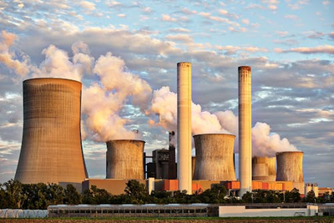
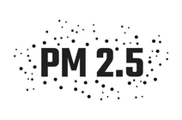
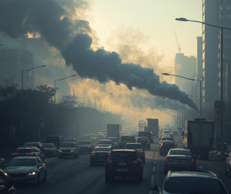
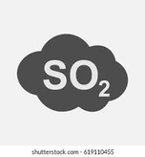

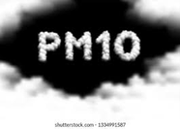
Problem Statement
Air pollution is a growing concern in urban environments, directly impacting human health and environmental quality. Accurate forecasting of air quality can help authorities take preventive measures, issue warnings, and inform the public.
Sources of air pollution
Key Pollutants
Risk of Air Pollution
Health problem
Respiratory Diseases
Cardiovascular Issues
Other Ailments
Particulate matter from combustion and dust, affecting lungs.
Gases from vehicles and industry, respiratory irritants.
Carbon monoxide from incomplete combustion, harmful if inhaled.
Environmental Impacts
Crop Damage
Climate Change
Ecosystem Degradation
Industrializationt
traffic congestion
SO₂
O₃
PM10
Gases from industry causing respiratory irritants.
Ground-level ozone impacting respiratory health directly.
Fossil fuels
Particulate matter affecting lung function significantly.
Deforestation

Slide 4
Air quality forecasting project
Purpose and focus of project
This project aims to build a time series forecasting system that predicts air quality index (AQl) and pollutant level using historical pollution data .The goal is to empower agencies, city planner,and the public with timely for heathier decision-making.
Project Objective
• A time series forecasting model to predict AQI and key pollutants (PM2.5, PM10, NO2, etc.).
• Visual dashboard showing historical trends and future air quality predictions.
• Alerts or warnings when predicted AQI crosses safety thresholds.
• Ability to analyze pollutant contributions and seasonal trends.
• Admin functionality to upload new datasets and retrain models for updated forecasting.

Slide 5
Technology Stack
Python for core development
Pandas/NumPy for data manipulation
Scikit-learn for machine learning models
TensorFlow for deep learning(LSTM) models
ARIMA for statistical time-series forecasting
Prophet for trend-based time-series forecasting
XGBoost-for boosting -based regression prediction
Streamlit for web application
Plotly/Matplotlib for visualization

Slide 6
Milestone 1:Data preprocessing and EDA
EDA (Exploratory Data Analysis)
Purpose: Understand data, detect patterns, missing values & outliers, plan features
Visualizations:
Time Series Plots – Show pollutant trends, daily cycles, support forecasting
Correlation Analysis – Identify related pollutants, improve model features
Statistical Summary – Mean, median, max/min; detect extremes
Distribution Analysis – Frequency of values, detect outliers, check skewness
Data Sources & Agencies
CPCB & SAFAR
Official government monitoring stations provide reliable data.
OpenAQ & WAQI
Crowdsourced platforms enhance coverage and engagement.

Slide 7
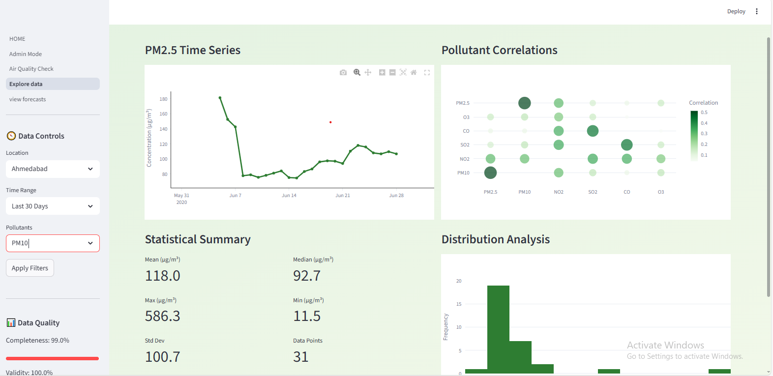
Dashboard 1
Air quality data explorer

Slide 8




Milestone 2
Model training and Evaluation
LSTM
XGBoost
Prophet
ARIMA
A deep learning model for sequential data analysis.
✔ Handles sequential time-series data like pollutant levels over hours/days
✔ Learns complex patterns & trends automatically
✔ Works well when data is large and pollution depends on previous values Useful for multi-step forecasting (next hour/day/week pollution levels)
A gradient boosting algorithm for high performance.
✔ Handles tabular data (pollutant values + weather features)
✔ Works well with small & medium datasets
✔ Captures non-linear relationships
✔ Faster and more accurate than normal regression models
✔ Good for feature importance — tells which factor affects pollution most
Prophet is an open-source time-series forecasting model developed by Facebook. It automatically detects:
✔ Trend
✔ Seasonality (daily, weekly, yearly)
✔ Holidays/festivals impact
ARIMA is a statistical time-series model that forecasts future values based only on past values. It combines:
AR (Auto Regression) – depends on previous values
I (Integrated) – makes data stationary
MA (Moving Average) – uses past errors

Slide 9
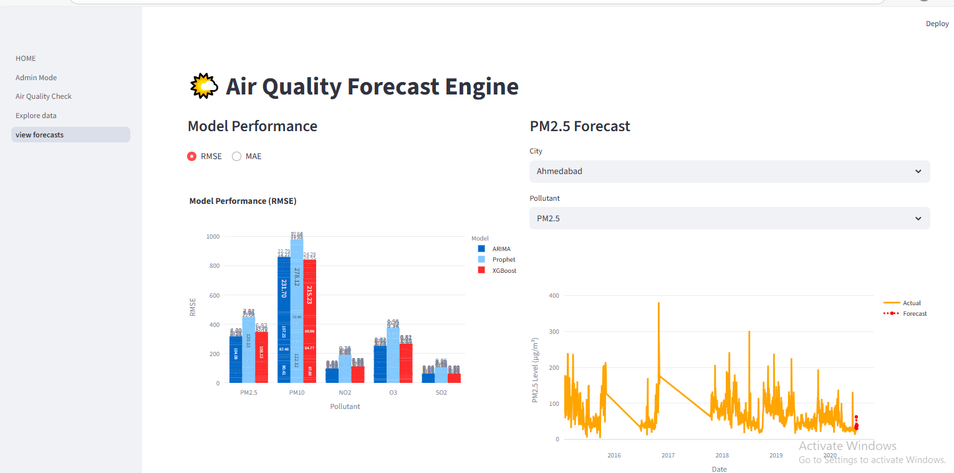
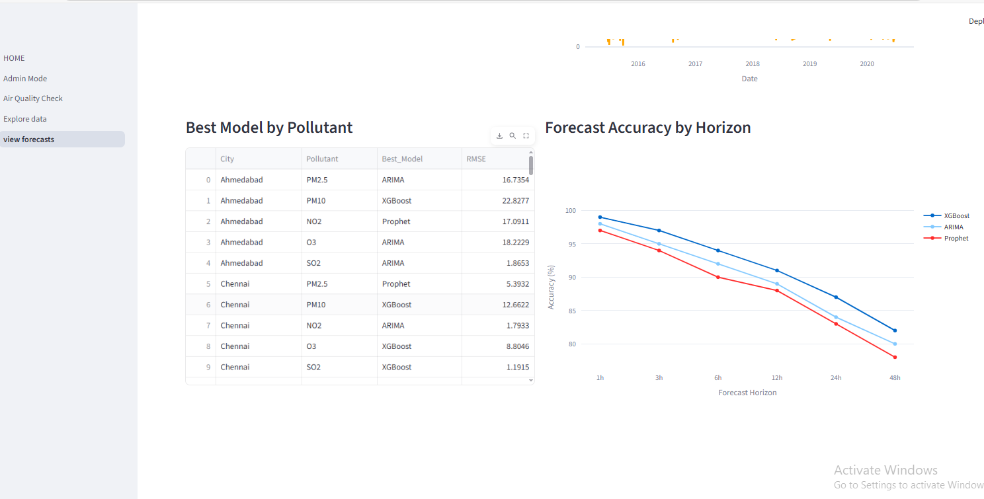
Visualization & Insights
Model Comparison Chart – Compare RMSE/MAE across pollutants
Forecast Graph – Actual vs predicted trends with confidence intervals
Best Model Table – Shows optimal model & performance per pollutant
Forecast Accuracy Chart – Accuracy vs forecast horizon

Slide 10
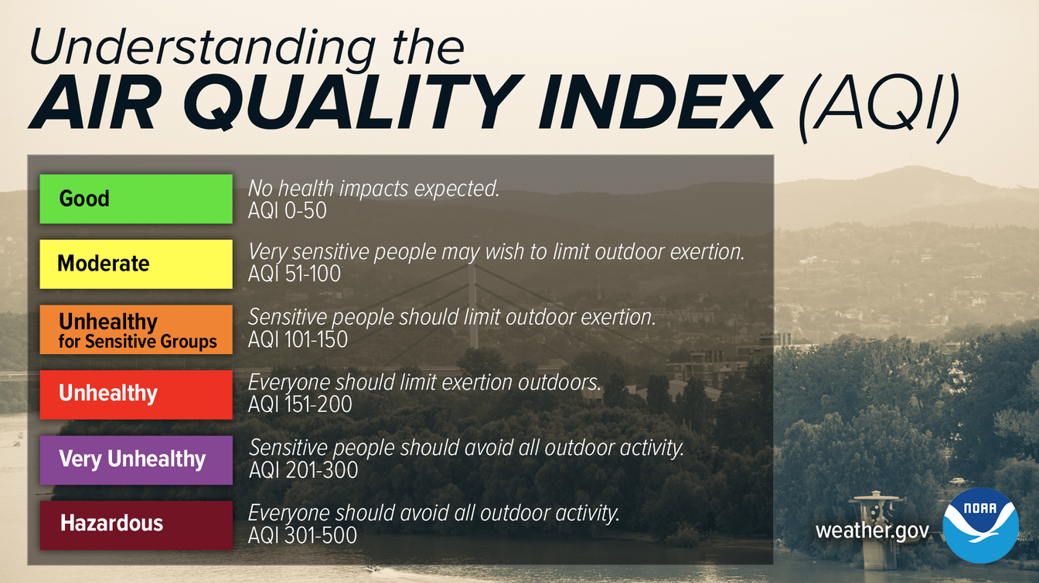
Milestone 3
Alert logic and visualization
what is AQI:-AQI is a standardized index that converts pollutant levels into a single value to represent overall air quality.

Slide 11
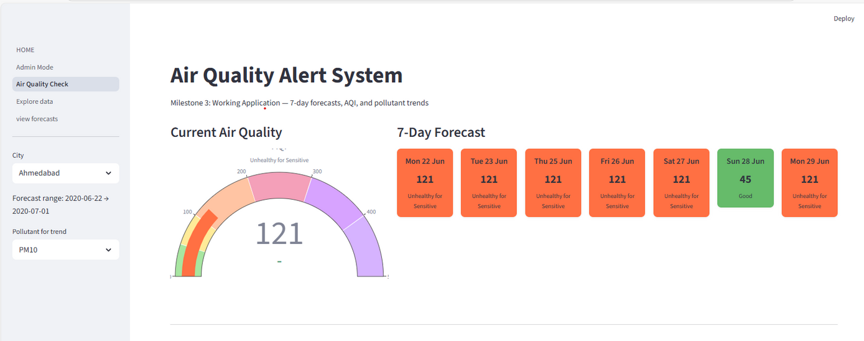
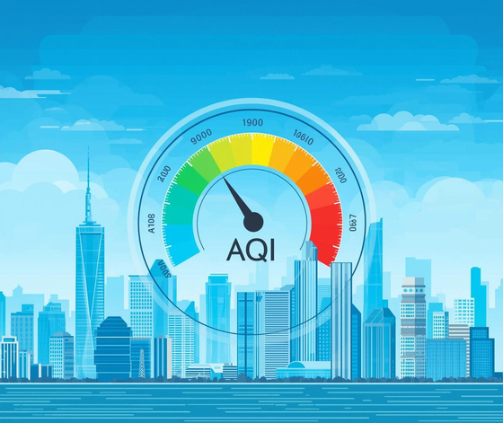
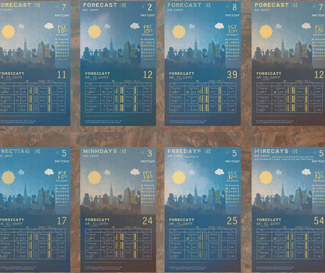
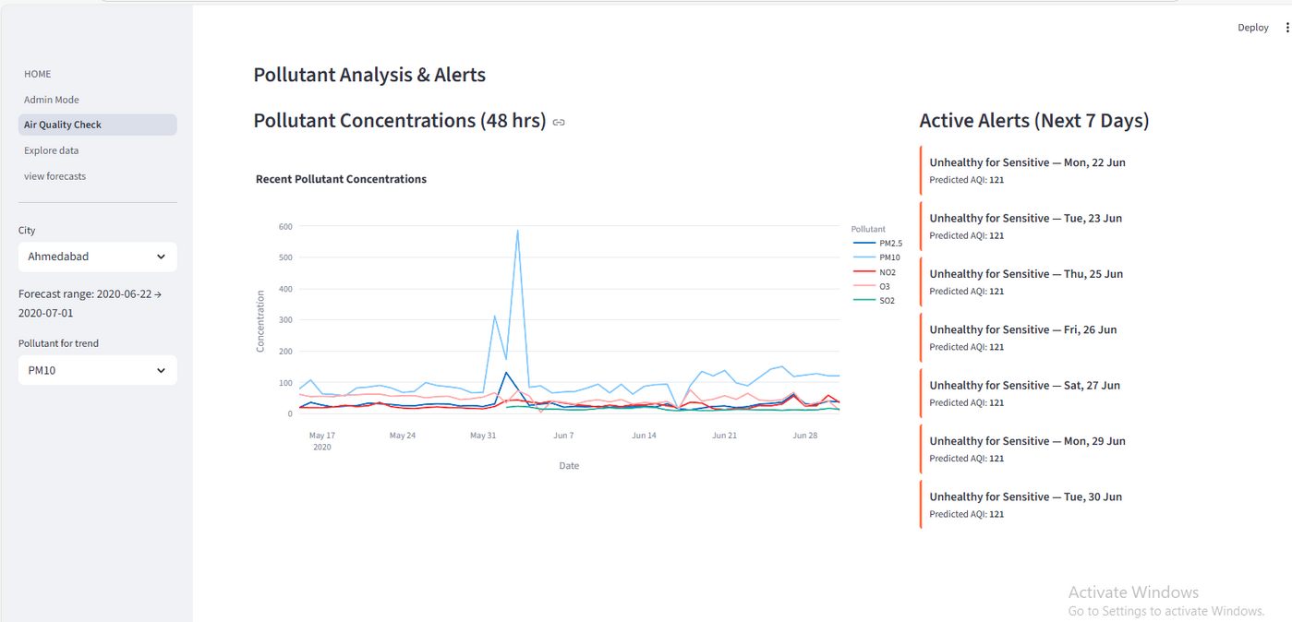
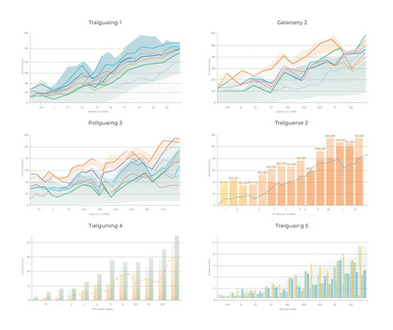
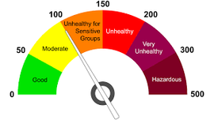
Visualization
Real-time AQI Gauge
7-day Forecast Cards
Display current air quality status dynamically.
Show upcoming air quality trends visually.
Pollutant Concentration Charts
Analyze detailed pollutant levels effectively.

Slide 12
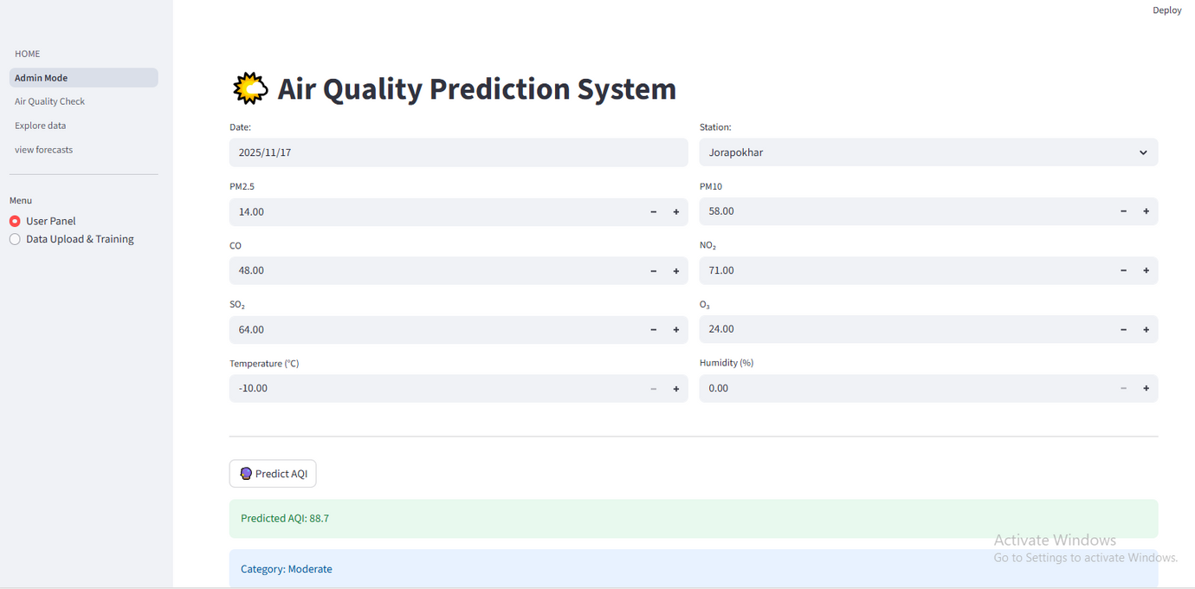
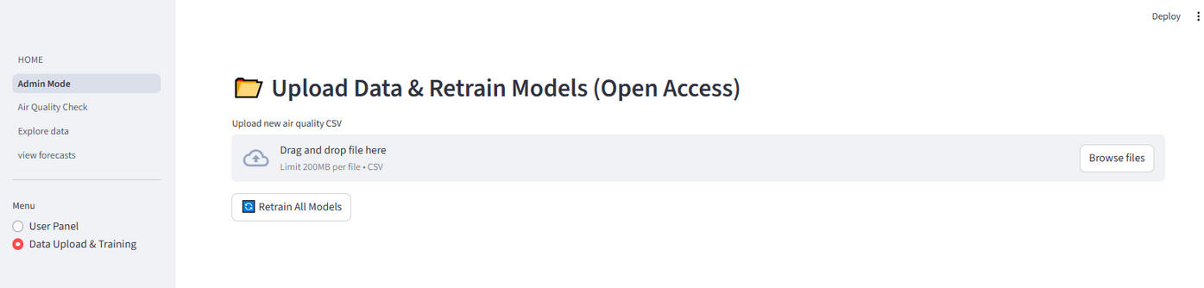
Milestone 4
streamlit web dashboard
1.Interactive UI to select station, timeframe, and forecast variable.
• Display AQI gauge, line plots, and alerts.
• Admin interface to upload new data and retrain models.

Slide 13
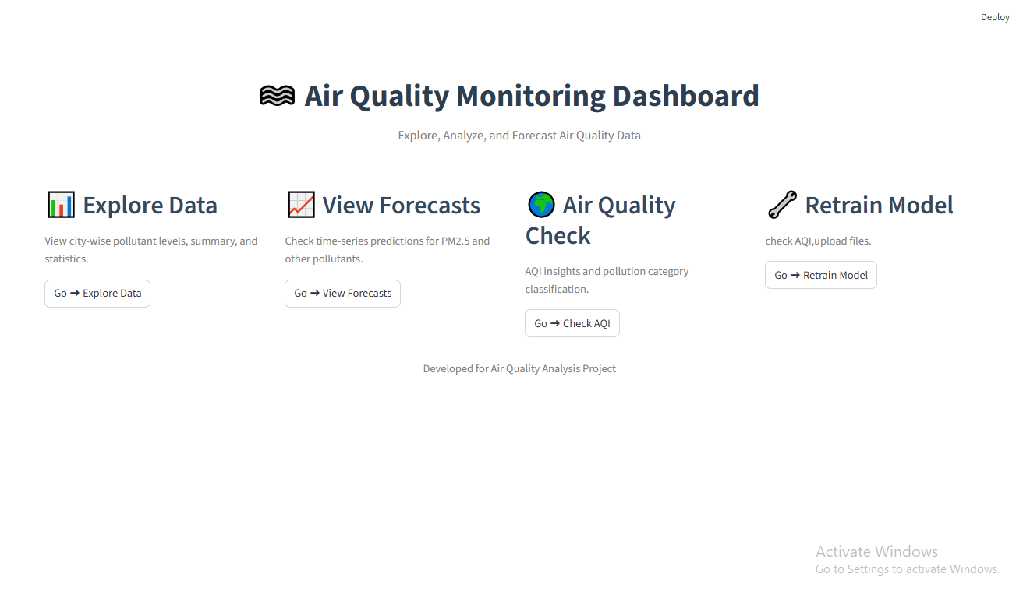

Slide 14
Thank You

